Slide 1
Introduction:
Hydropower is energy from water sources such as the ocean, rivers and waterfalls. “Mini- hydro” means which can apply to sites ranging from a tiny scheme to electrify a single home, to a few hundred kilowatts for selling into the National Grid. Small-scale hydropower is one of the most cost-effective and reliable energy technologies to be considered for providing clean electricity generation. The key advantages of small hydro are:

Slide 2
High efficiency (70 - 90%), by far the best of all energy technologies.
High capacity factor (typically >50%)
High level of predictability, varying with annual rainfall patterns
Slow rate of change; the output power varies only gradually from day to day (not from minute to minute).
A good correlation with demand i.e. output is maximum in winter
It is a long-lasting and robust technology; systems can readily be engineered to last for 50 years or more.

Slide 3
It is also environmentally benign. Small hydro is in most cases “run-of-river”; in other words any dam or barrage is quite small, usually just a weir, and little or no water is stored. Therefore run-of-river installations do not have the same kinds of adverse effect on the local environment as large-scale hydro.

Slide 4
Overview
Small hydropower stations are usually run off schemes. Modern micro-hydro power(MHP) plants use turbines instead of water wheels and mostly power a generator to produce electricity. Such systems are purely mechanical and therefore extremely robust.

Slide 5
Technical
Scheme components
Water into Watts
Suitable conditions for Micro-hydro power
Turbines
Load factor

Slide 6
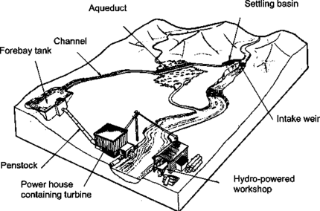
Figure 1 shows the main components of a run-of-the-river micro-hydro scheme. This type of scheme requires no water storage but instead diverts some of the water from the river which is channelled along the side of a valley before being 'dropped' into the turbine via a penstock. In figure 1, the turbine drives a generator that provides electricity for a workshop. The transmission line can be extended to a local village to supply domestic power for lighting and other uses.

Slide 7
Other issues
The economics-cost reduction
Ownership management
Low-cost grid connection

Slide 8
This includes such innovations as:
using run of river schemes where possible - this does away with the cost of an expensive dam for water storage
locally manufactured equipment where possible and appropriate
using existing infrastructure, for example, a canal which serves an irrigation scheme
siting of power close to village to avoid expensive high voltage distribution equipment such as transformers
use of local materials for the civil works
use of community labour
low-cost connections for domestic users
self-cleaning intake screens - this is a recent innovation which is fitted to the intake weir and prevents stones and silt from entering the headrace canal; this does away with the need for overspill and desilting structures along the headrace canal and also means that, in many cases, the canal can be replaced by a low-pressure conduit buried beneath the ground - this technology is, at present, still in its early stages of dissemination

Slide 9
Reduced service connection costs. Limiting load supply can also help reduce costs on cable, as the maximum power drawn is low and so smaller cable sizes can be used. Also, alternative cable poles can sometimes be found to help reduce costs.

